Slide 3
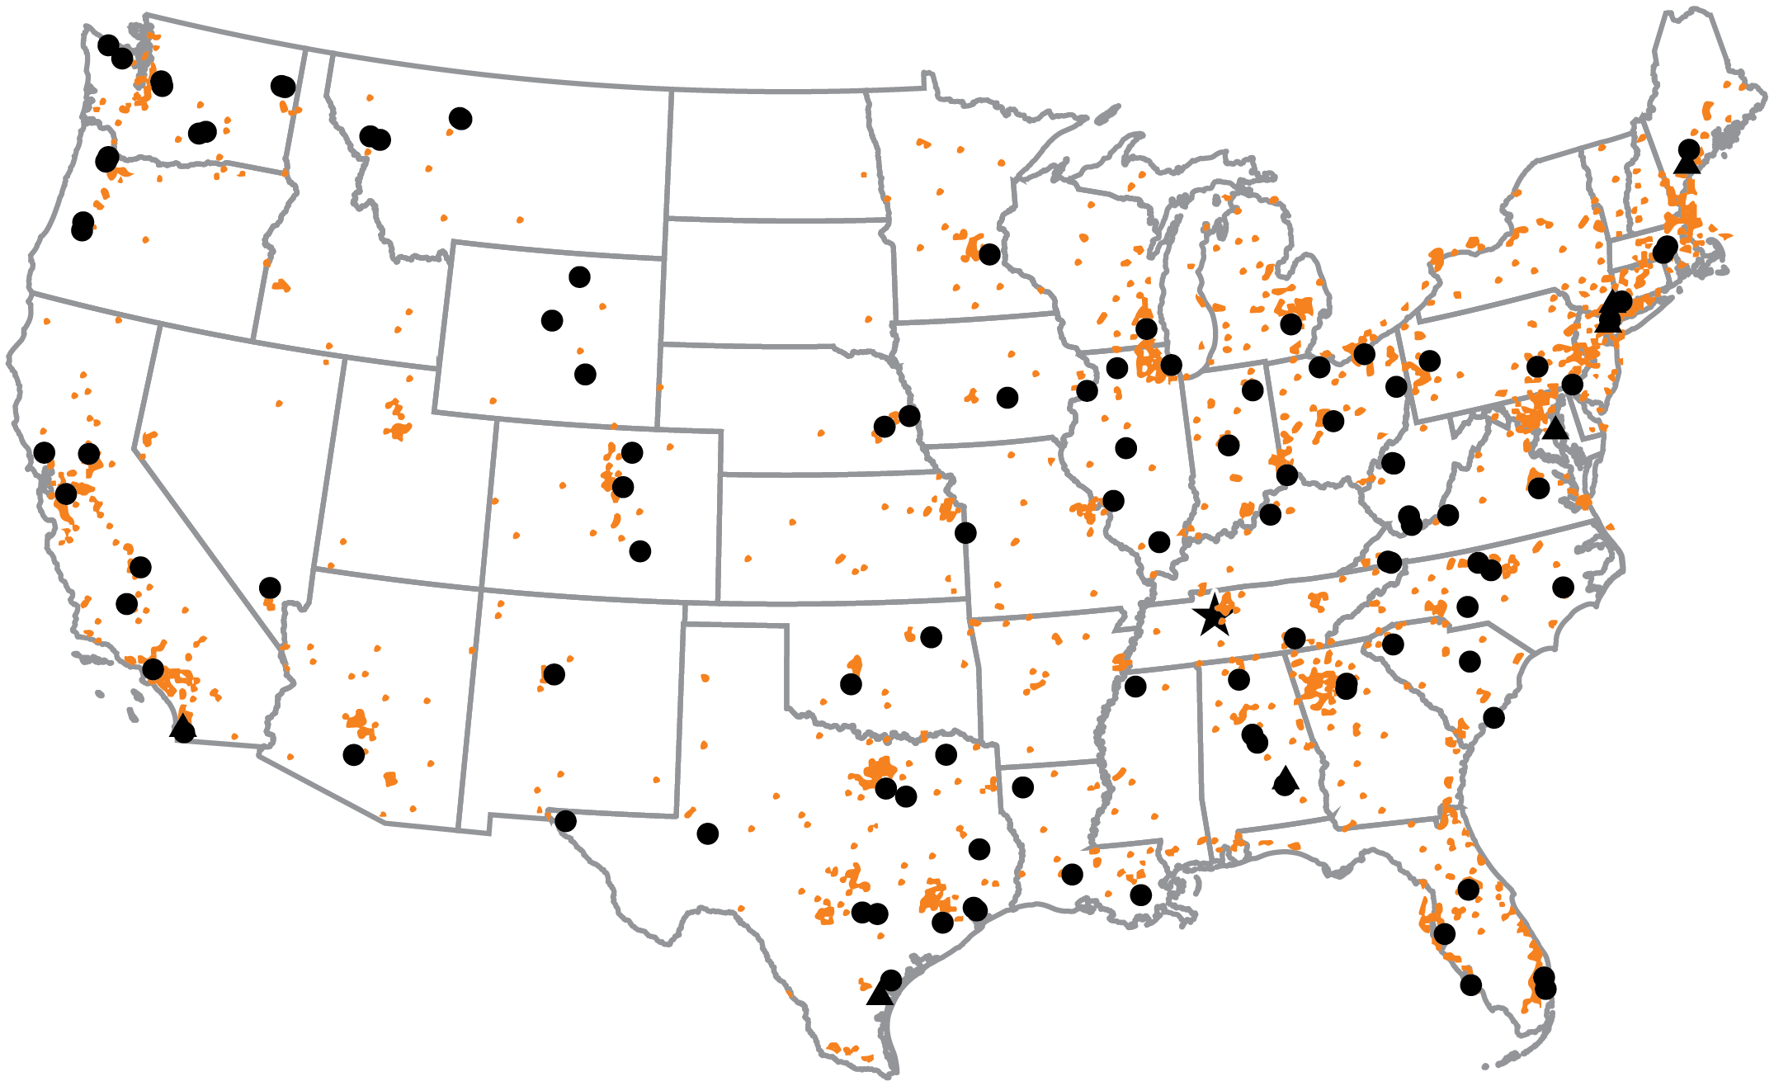
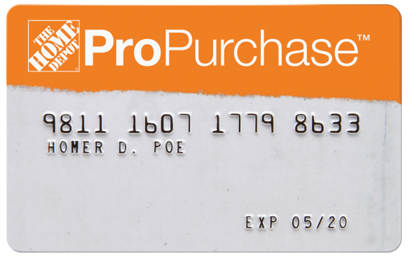
Extra Convenience
68 Distribution Centers and 2,000 Home Depot Stores

Slide 4
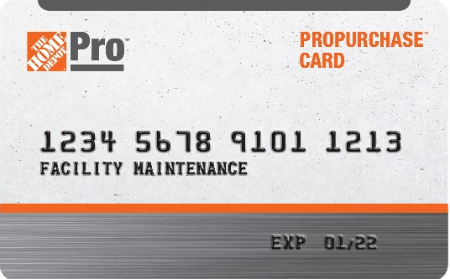
The ProPurchase Program for Your Business
Shop anywhere with your existing Home Depot Pro credit line. In stores or online, we’ve got you covered.
Program Benefits
More Ways to Shop
Supplement your supply orders from The Home Depot Pro by shopping on homedepot.com or at The Home Depot® stores nationwide, all applied to your existing credit line.
Expanded Product Selection
Gain access to an expanded assortment of products, including lumber, drywall, insulation and even truck and tool rentals.
One Account Billing
All purchases made in-store or on homedepot.com using a ProPurchase card appear on your Home Depot Pro account invoice for easy payment management and account visibility.
Multiple Cards &
Spend Controls
Assign unique cards to employees or locations, and add optional weekly or monthly spend limits to each card.
Earn Pro Xtra Rewards
If you are a Home Depot Pro Xtra rewards member, you can easily register your ProPurchase card as a payment method on your Pro Xtra account.
NEW!
Now accepted on homedepot.com

Slide 5
More Products, More Possibilities
Over 140,000 products from more than 3,000 manufacturers

Slide 6
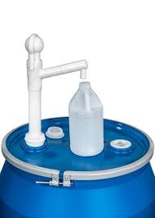
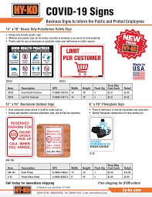
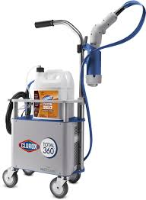
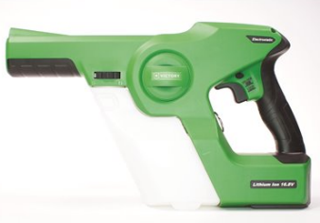
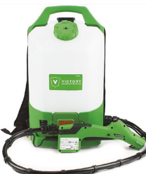
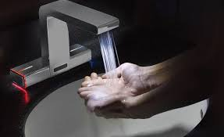
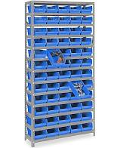
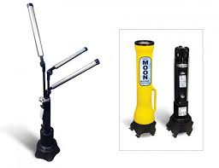
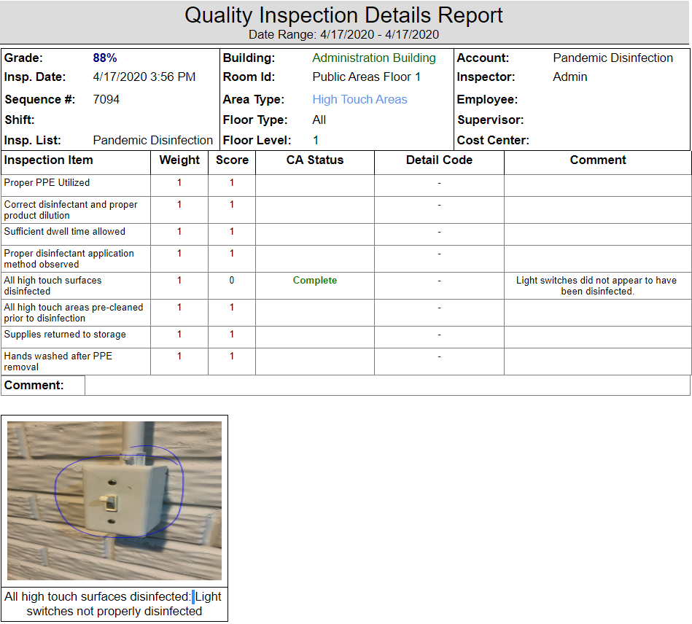
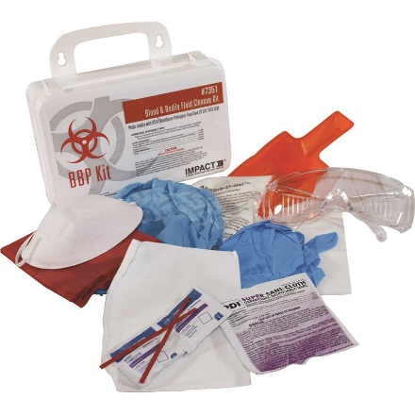
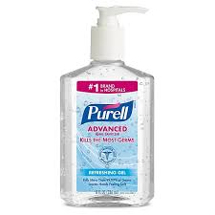
Innovative Pandemic Solutions
Pandemic kit

Slide 7
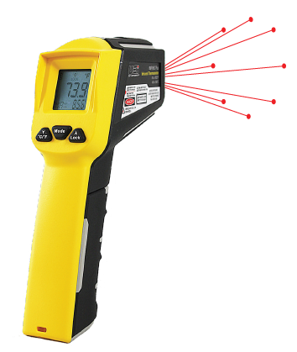
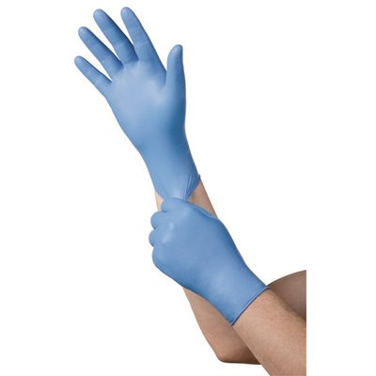
Safety and PPE
Gloves and Masks

Slide 8
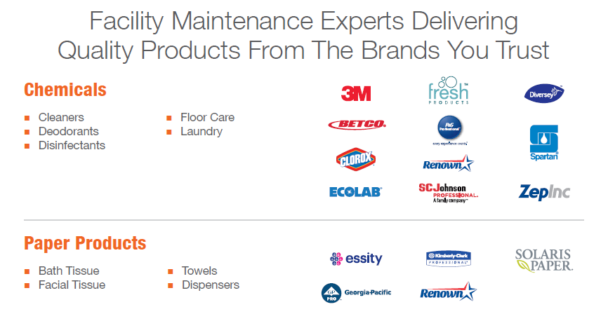

Slide 10
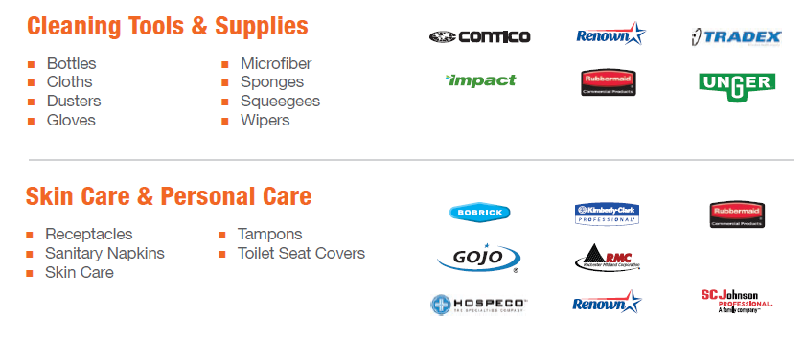

Slide 11
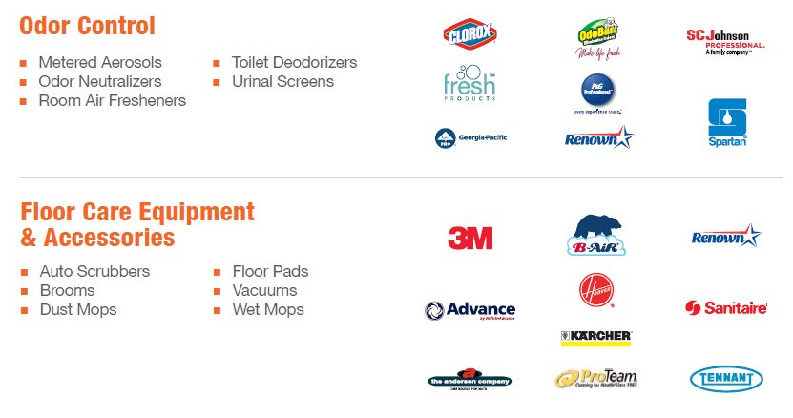

Slide 17
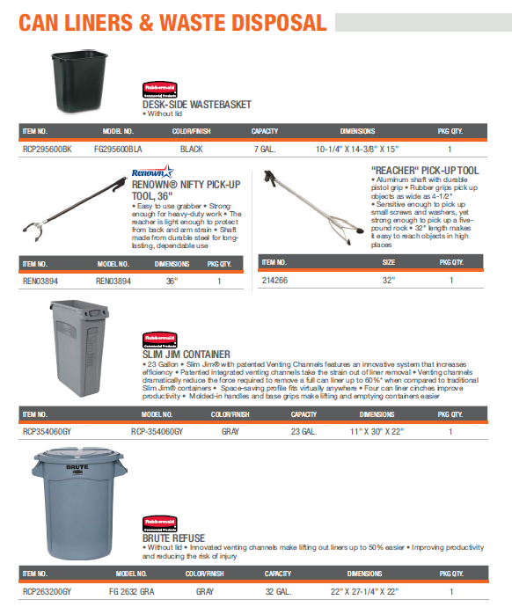
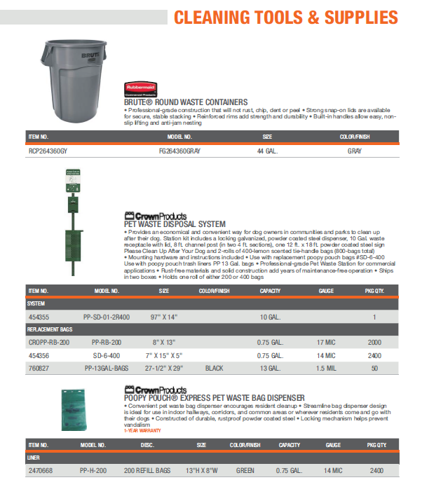

Slide 18
Pete Farrugia / Senior Account Manager
Home Depot Pro | Institutional 650 Brennan St., San Jose, CA 94544 Cell # (650)207-2051
Peter_C_Farrugia@homedepot.com
www.homedepotpro.com/institutional

